Slide 1

Data Analysis Project Report
Hotel and Resort Booking

Slide 2
Contents
Project overview and scope
Business problem and objective
Assumptions
Research Questions
Hypothesis
Data collection and understanding
Data Analysis and Findings
Suggestions
Notes:
Change

Slide 3
Project Overview and Scope
This project is for city hotels or resorts. The purpose of project is minimizing cancellation rates. The cancellation rates in city hotels and resorts are significantly increasing leading to revenue loss. So, our aim is to lower the cancellation rates in order to increase their efficiency in generating revenue.
Project Deliverables
Milestone | Deliverable
Identifying factors leading to cancellation and irrelevant factors that have no bearing on business yearly revenue generation. | Deliverable 1.1—Identifying factors leading to cancellation Deliverable 1.2—Identifying irrelevant factors that have no bearing on business yearly revenue generation. Deliverable 1.3— Data Identification and Collection
Explore and clean the data | Deliverable 2.1— EDA and Data cleaning using python Deliverable 2.2— Using SQL
Data analysis, visualization and final report | Deliverable3.1 – Analyze the data to get meaningful insights using python Deliverable3.2 – Present the final report in ppt

Slide 4
Business Problem: The cancellation rates in city hotels and resorts are significantly increasing leading to revenue loss.
Business Objective: Minimizing cancellation rates
Assumptions:
1.The data have no outliers.
2. The information is current and correct to the best of knowledge.
3.The biggest factor in revenue loss is cancelled booking which results in vacant rooms for the booked length of time.
4. The clients are cancelling the booking before the reporting date.

Slide 5
Research Question: 1. What are the factors affecting hotel cancellation? 2. How can we reduce the cancellation? 3. How to assist hotels in making pricing and promotional decisions? Hypothesis: 1. More cancellation occurs when prices are higher. 2. When there is a longer waiting list, customer tends to cancel more frequently. 3. Majority of clients are coming from offline travel agents to make their reservation.

Slide 6
Data Collection: Data is downloaded from Kaggle Data Understanding:
Data set consists of about 36 columns and 119390 rows
The datasets contains the booking information of two hotel. One of the hotels is a resort hotel and the other is a city hotel.
Each observation represents a hotel booking between the 1st of July 2015 and 31st of August 2017, including booking that effectively arrived and booking that were canceled.
The columns on which we will work are:-
‘is_canceled’ column : values indicates if the booking was canceled (1) or not (0).
‘reservation_status_date’ column represents the date of booking
‘adr’ column represents the average daily rate for hotel bookings.
‘market_segment’ column which represents way of booking i.e online travel agent, offline travel agents, direct booking or corporate

Slide 7
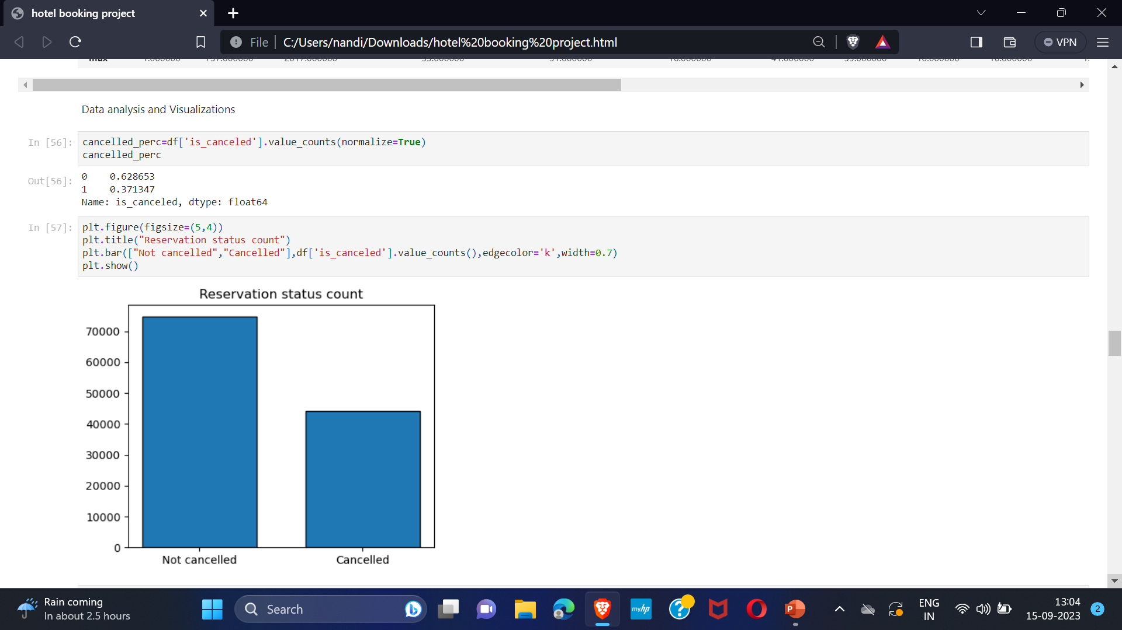
Analysis and Findings
The bar graph shows the percentage of reservations cancelled and those are not cancelled. There are 37% clients those who have cancelled the reservations.

Slide 8
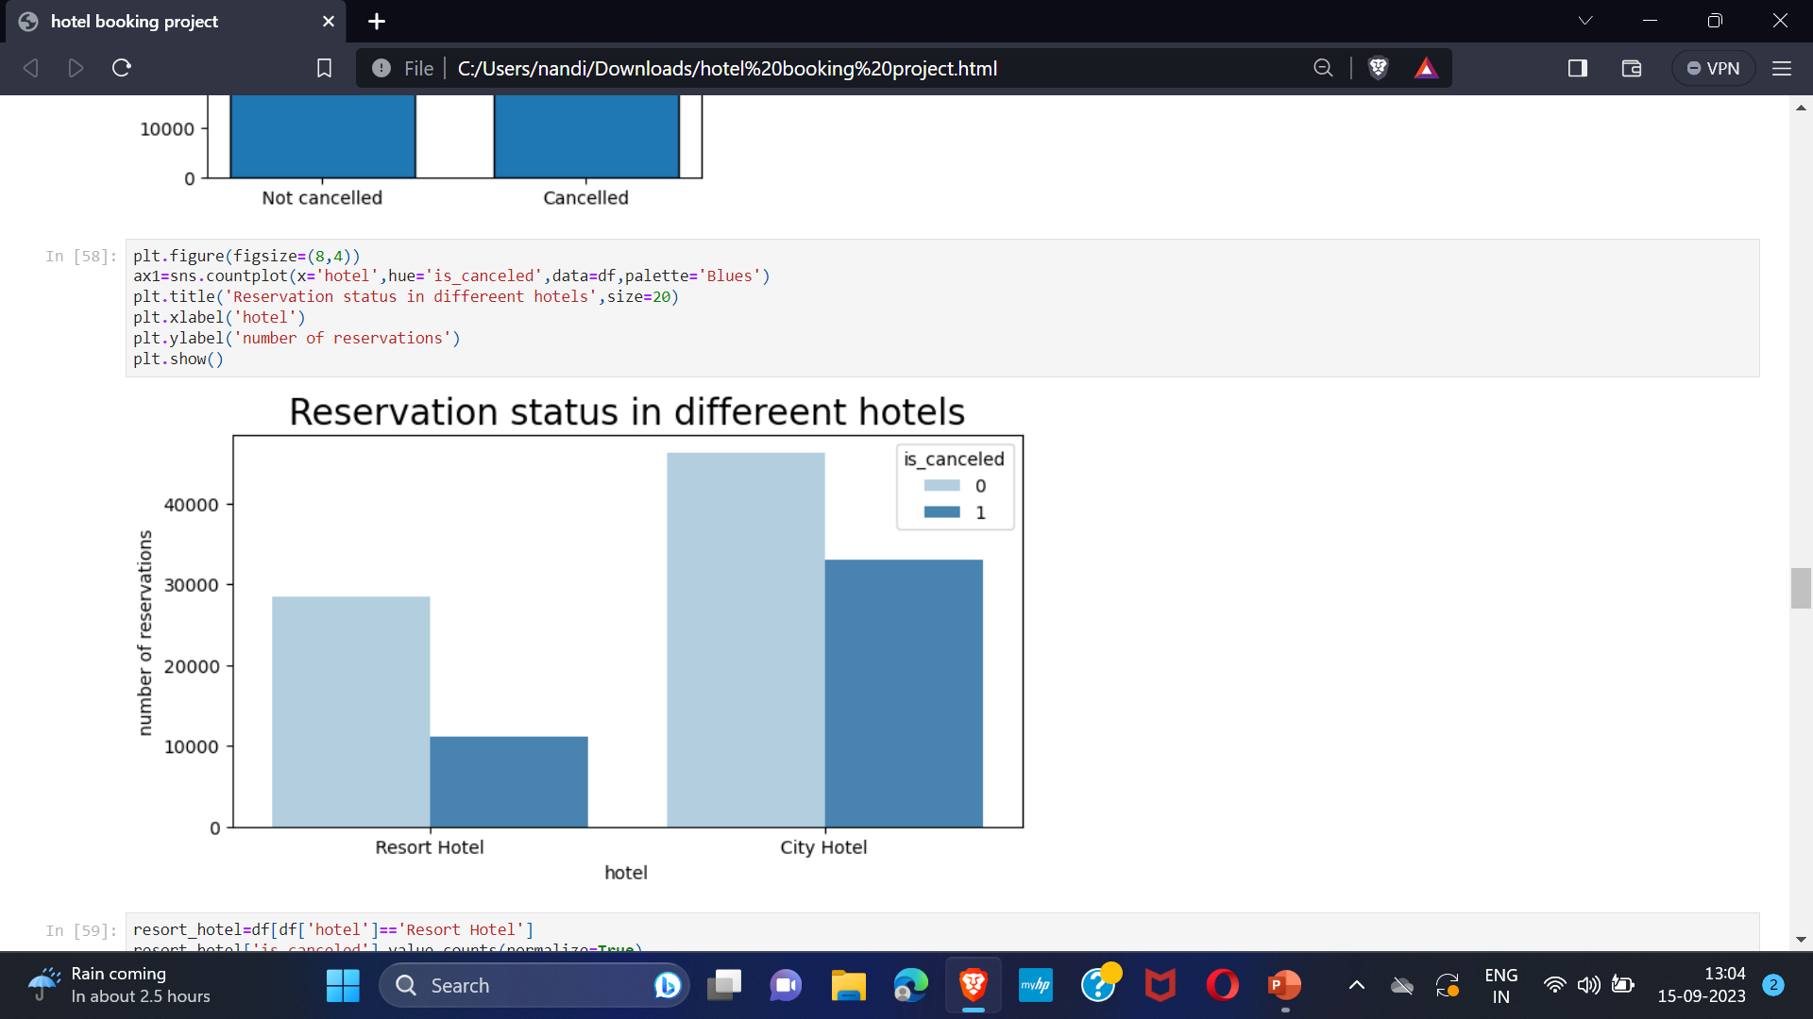
In comparison to resort hotels, city hotels have more bookings and also the cancellation is high. This may be because resort hotels might be more expensive than city hotels.

Slide 9
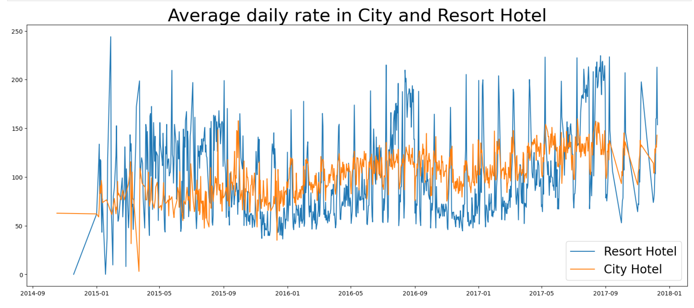
The line graph shows that, on certain days, the average daily rate for a city hotel is less than that of a resort hotel, and on other days, it is even less. It can also be said that in weekends and holidays a rise is seen in resort hotel rates.

Slide 10
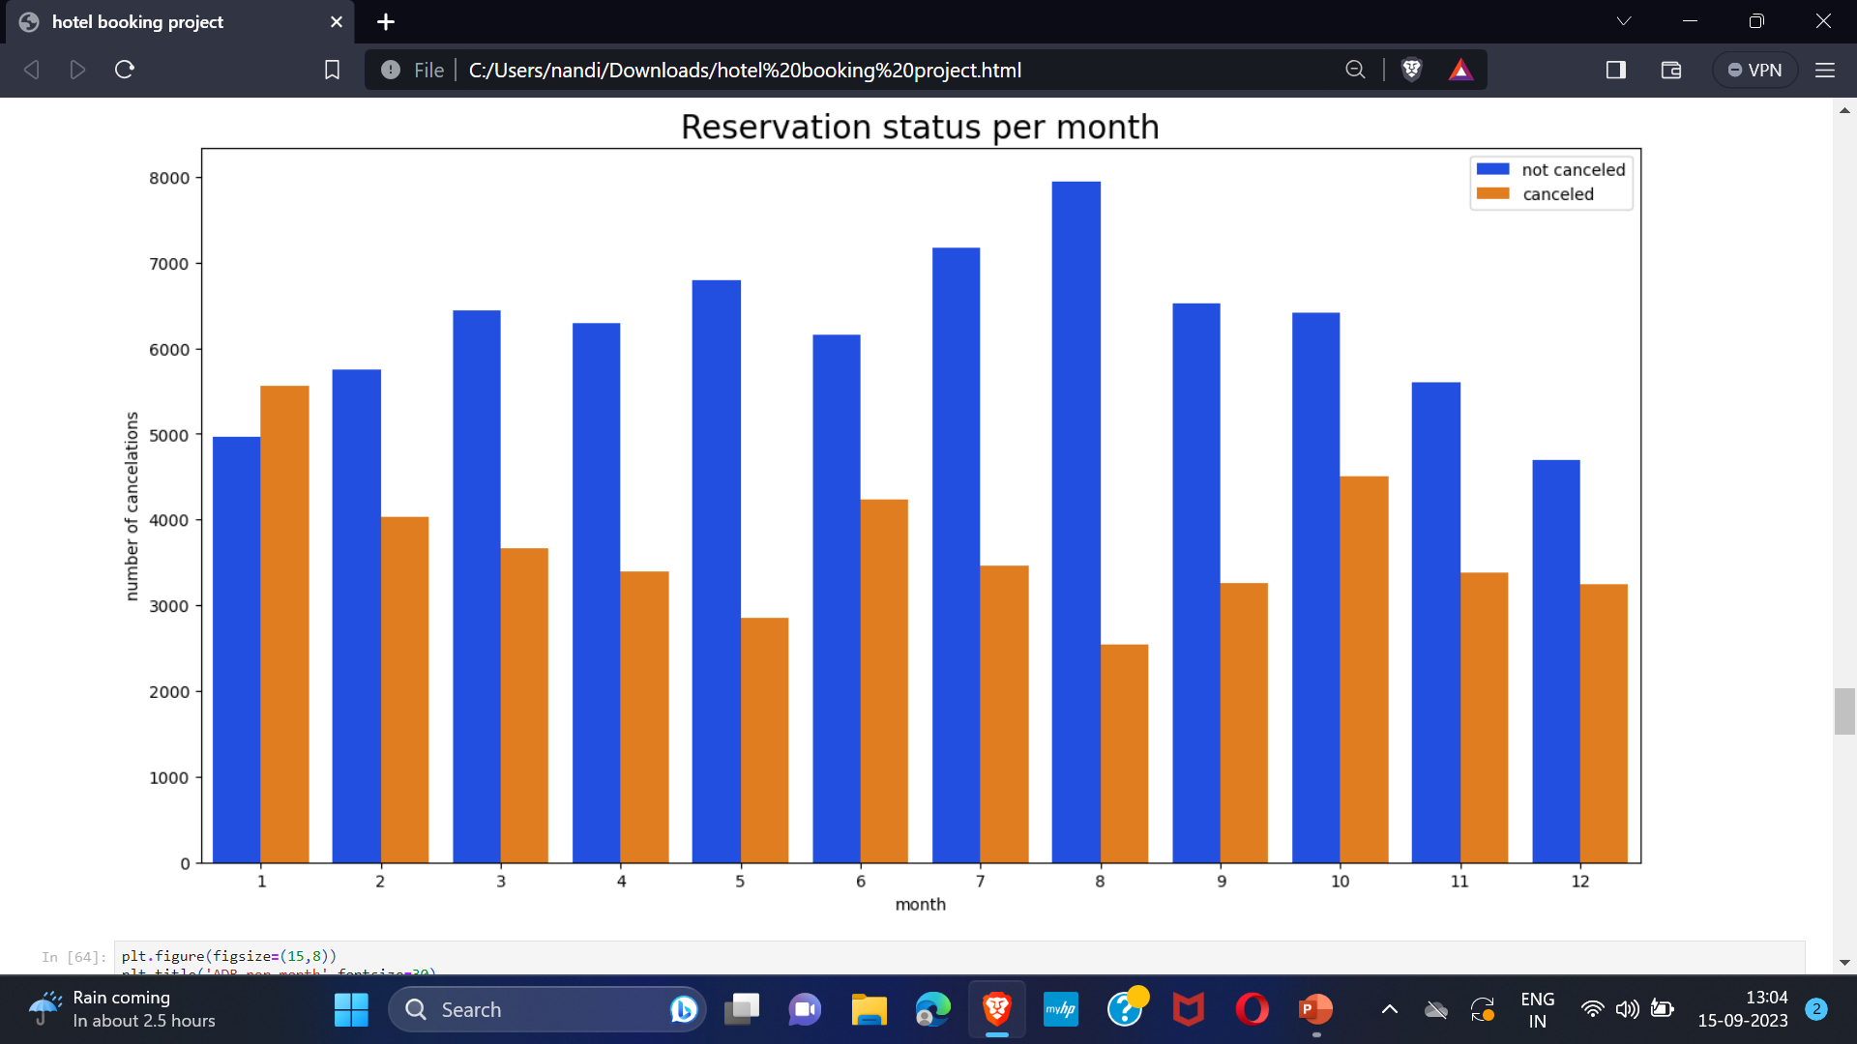
The bar graph shows the months with number of cancelled and confirmed bookings. This can be used to analyze the month with highest and lowest confirmed and cancellation rates. As it can be seen clearly that August has highest confirmed booking and January has highest cancelled bookings.

Slide 11
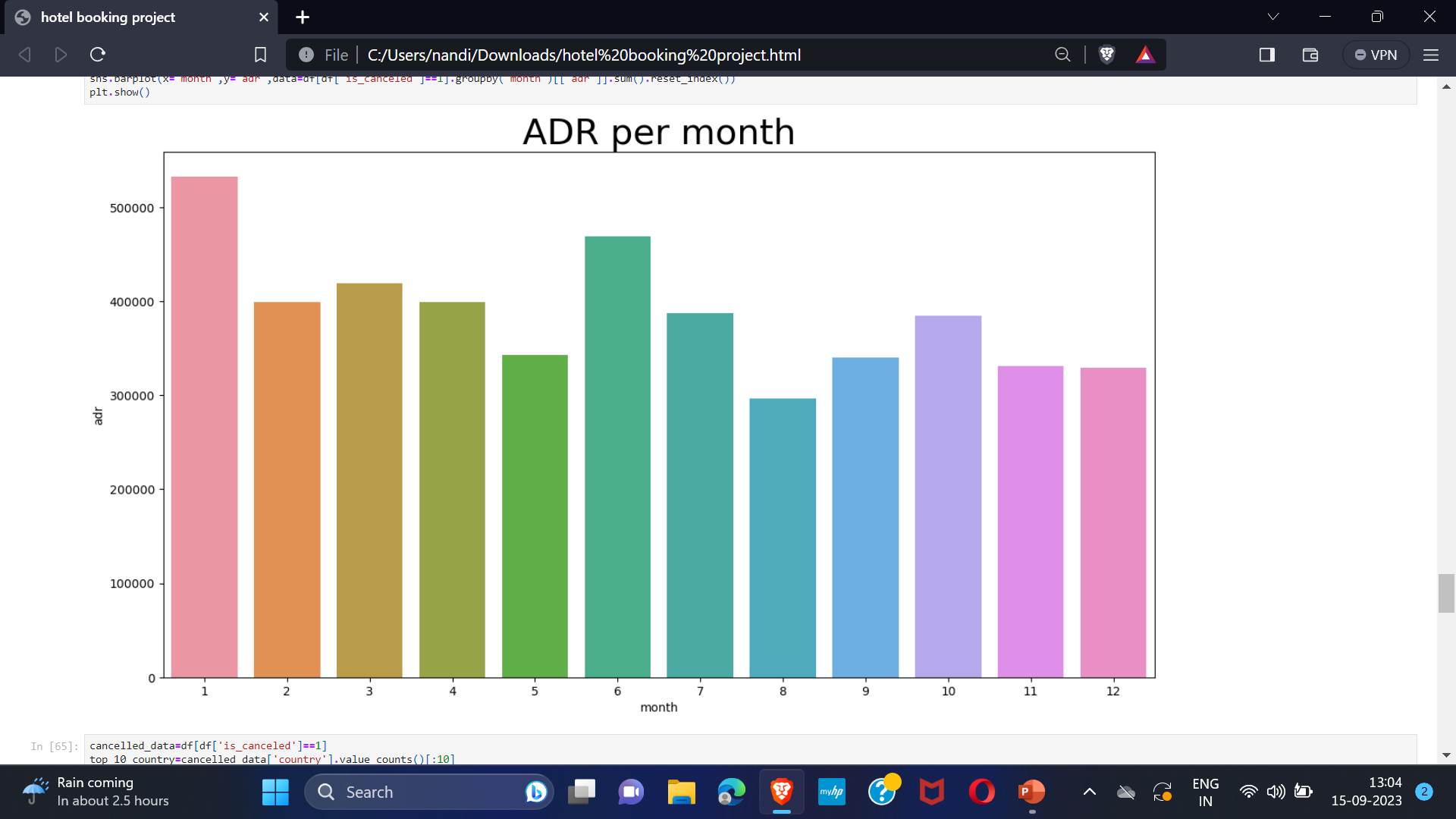
This bar graph demonstrates that cancellations are most common when prices are high and less when prices are low. Therefore, cost of accommodation is solely responsible for the cancellations.

Slide 12
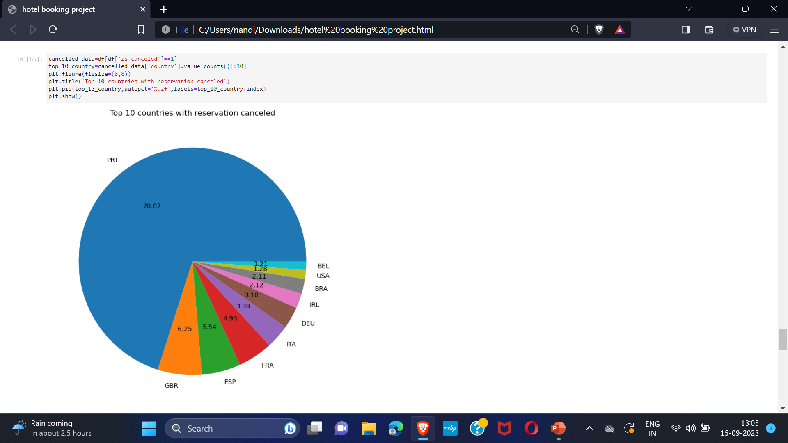
The pie graph shows that Portugal is the country with highest cancellation rate.

Slide 13
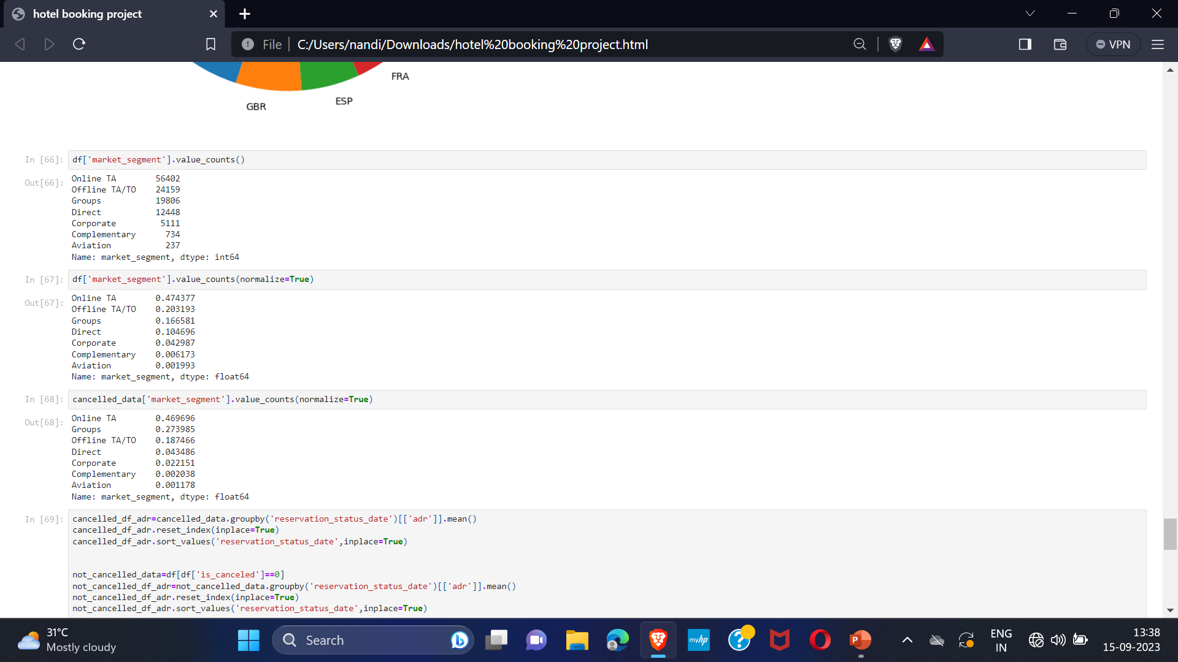
Now we are checking the mode of reservations of the cancelled bookings that is from where guests with cancelled bookings are getting there bookings done: Direct or groups , online or offline travel agents??
We can see that around 46% of cancelled bookings are from clients that come from online travel agents, whereas 27% from groups. Only 4% are those who directly visit hotels and make bookings.

Slide 14
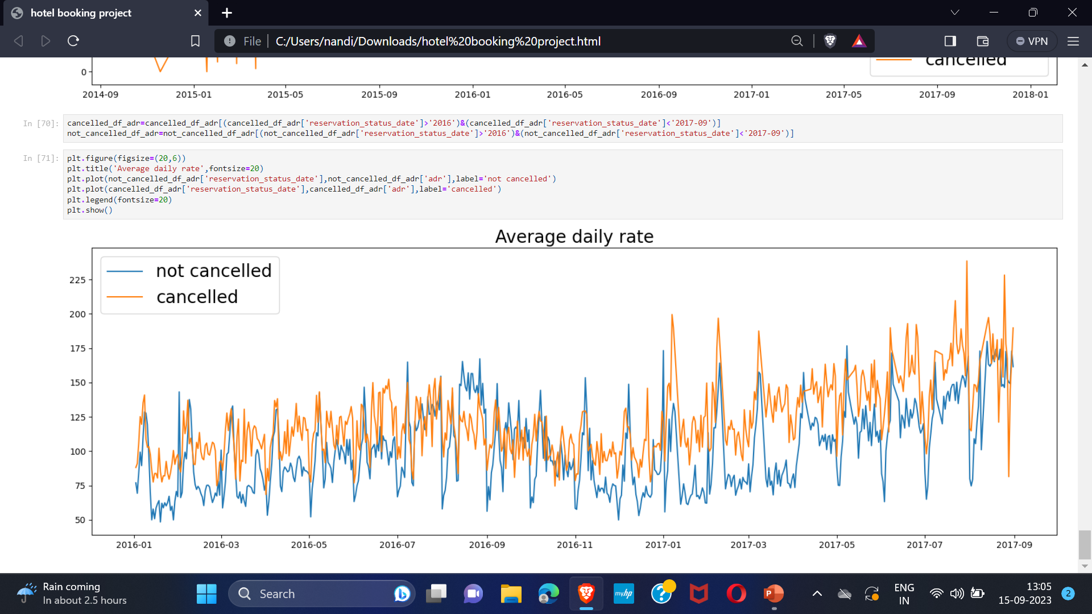
As seen in the graph, reservations are cancelled when the average daily rate is higher than when it is not cancelled. Hence, all the above analysis clearly shows that the higher price leads to higher cancellations.

Slide 15
Suggestions
Cancellation rates increases with price. In order to minimize cancellation rates, hotels should wok on their pricing strategies and try to lower the rates for specific hotels based on locations. They can also provide some discounts.
As the ratio of cancellation of city hotels is higher than resort hotels, so they should provide reasonable discounts on their rooms in weekends and holidays.
Since, cancellation is highest in January, so hotels can do some marketing and campaigns during that month to increase their revenue.
Hotels can also increase their quality and services to reduce cancellation mainly in Portugal.

Slide 16


